Slide 1
MOOD
For each of the following pictures, identify the mood by checking the box or generating your own word to articulate the general feeling or atmosphere contained within the image.

Slide 2
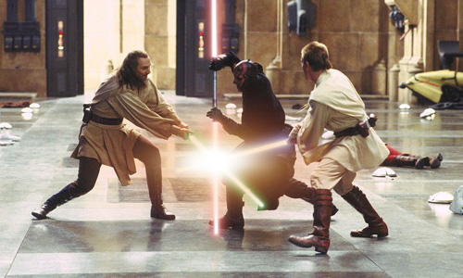
Contentious
Harmonious
Uninspired
Playful
Star Wars

Slide 3
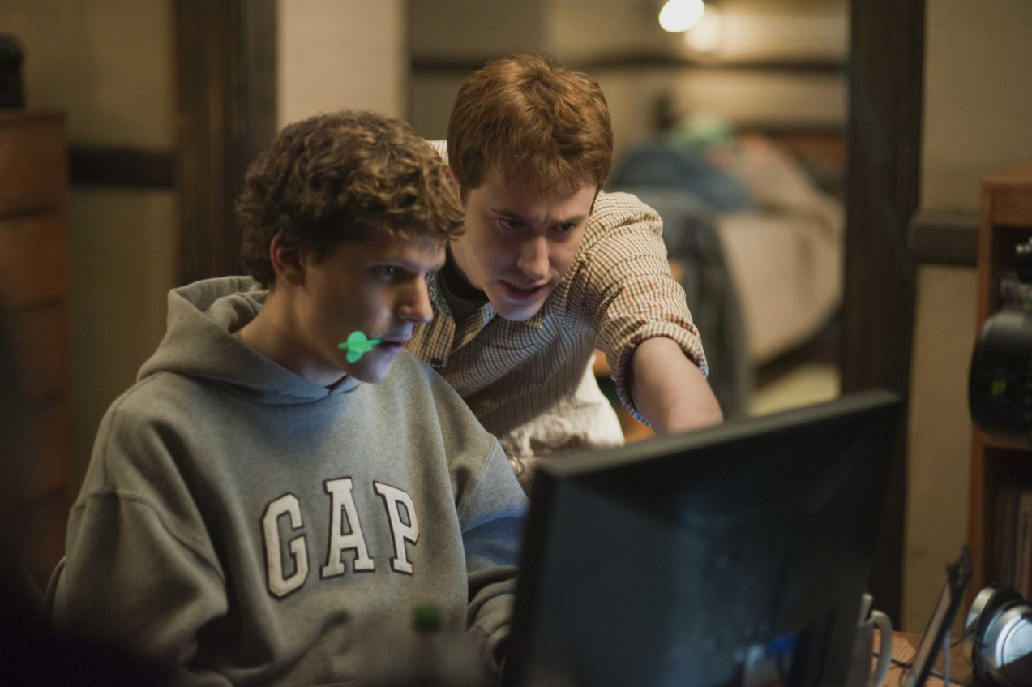
Dignified
Irritated
Focused
Anxious
Social Network

Slide 4
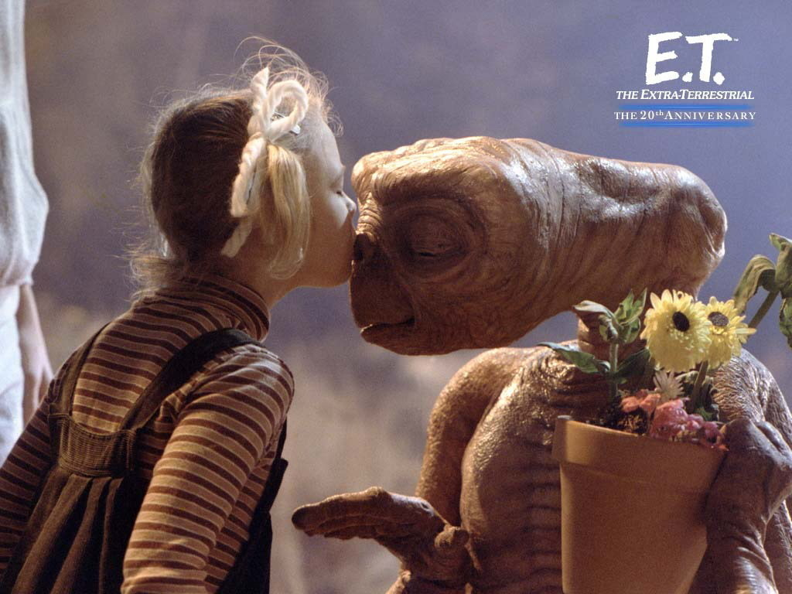
Numb
Bouncy
Loving
Regretful
E.T.

Slide 5
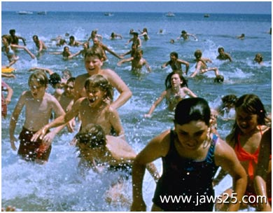
Giddy
Hostile
Chaotic
Embarrassed
Jaws

Slide 6
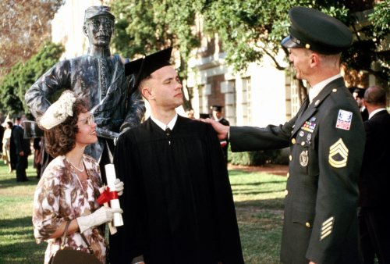
Dreamy
Heartbroken
Congratulatory
Lonely
Forrest Gump

Slide 7
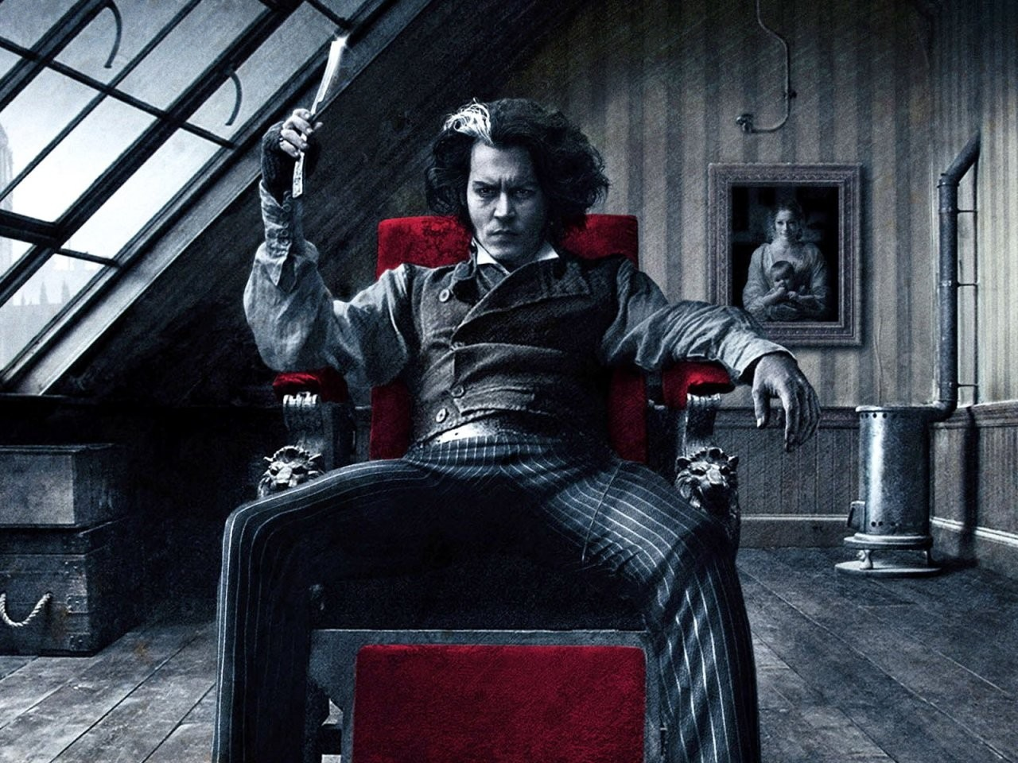
Welcoming
Frustrated
Passionate
Foreboding
Sweeney Todd

Slide 8
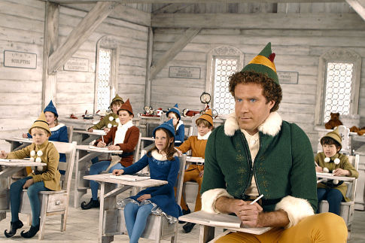
Warm
Indifferent
Awkward
Depressed
Elf

Slide 9
Your Own Mood Word: __________________
Pan’s Labyrinth

Slide 10
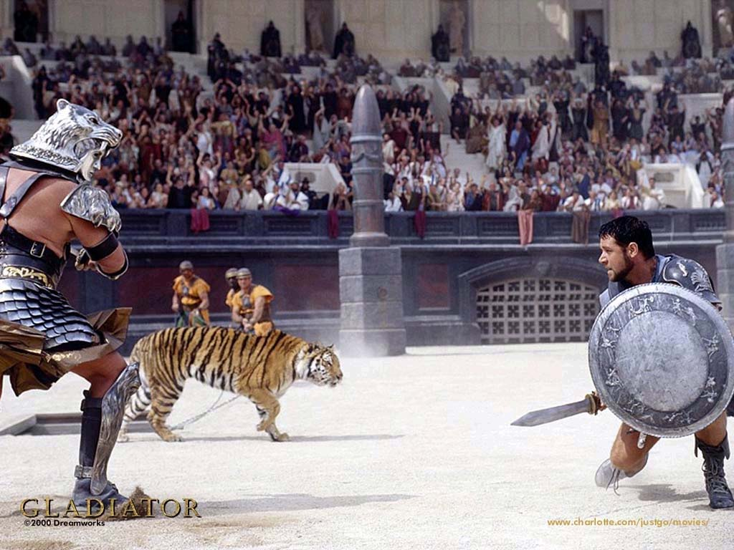
Your Own Mood Word: __________________
Gladiator

Slide 11
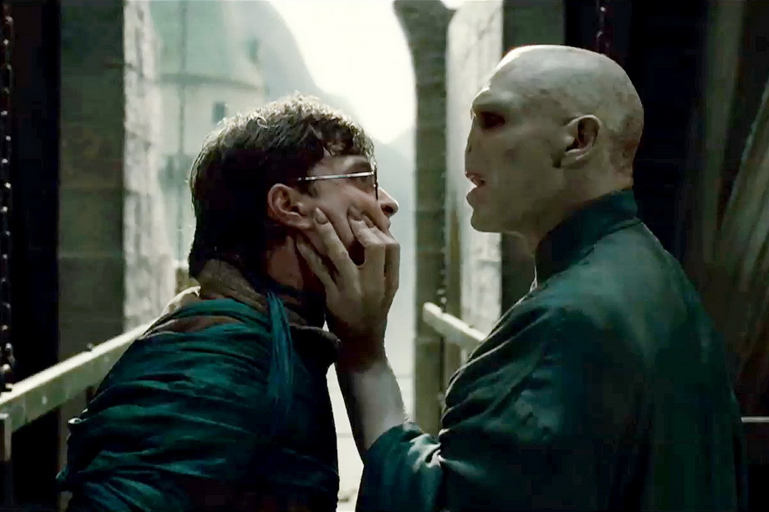
Your Own Mood Word: __________________
Harry Potter

